Slide 1

A gamified introduction to Python Programming Lecture 2 Basic Concepts of Programming
Matthieu DE MARI – Singapore University of Technology and Design

Slide 2

Outline (Chapter 2)
Everything you need to know about variables: Naming conventions, types, IDs, assignments, types conversions.
Using basic math operators in Python on mathematical variables: +, -, *, /, //, %, **.
Combining operators and assignments.
Commenting: in-line, block, docstring and header comments.
Printing and getting: displaying with print(), getting with input().
And more things!

Slide 3
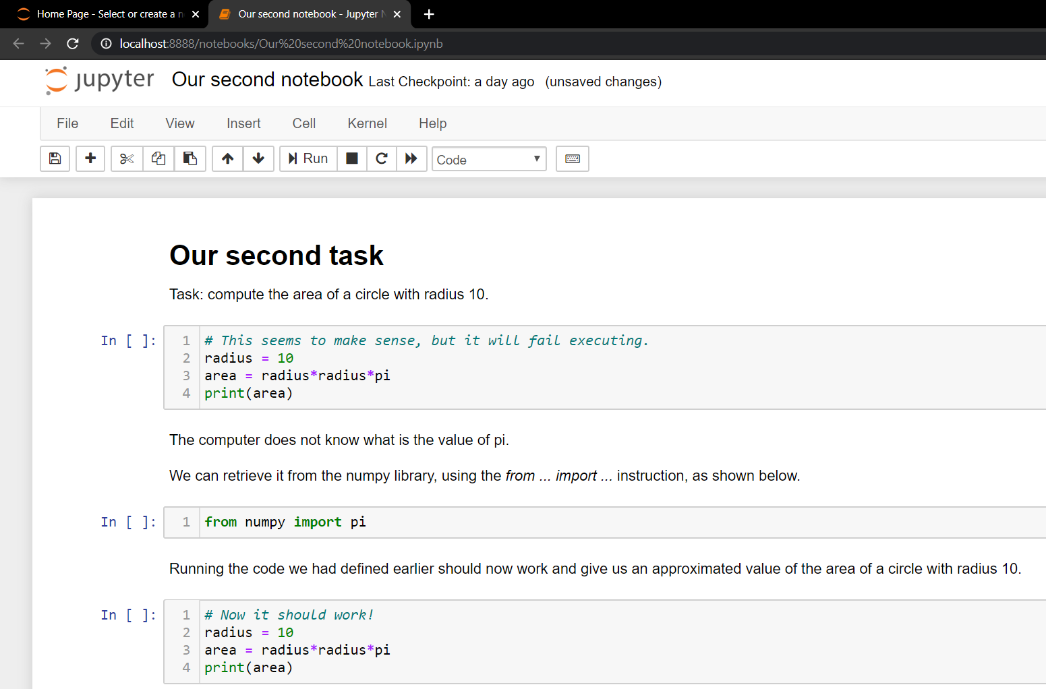
Recall: our second task in Lesson 1
In this task, we have intuitively used a few concepts, such as:
Assigning values to memory (variables)
Using basic math operations
Commenting your code
Printing
Executing a coding script in console or an IDE
(Importing stuff, for later!)
→ In the next couple of slides, we will go deeper into these concepts.

Slide 4
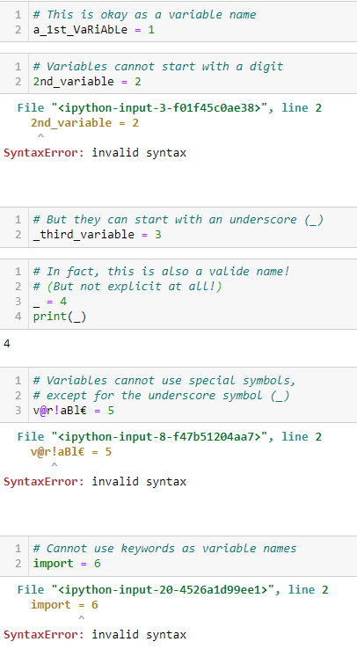
About variables names
Definition (Naming Convention for variables):
Variables names can include any combination of letters (both lowercase and uppercase), digits and underscore symbols (_).
Variables names should NOT start with a digit.
Some keywords (e.g. import) are protected and should not be used.

Slide 5

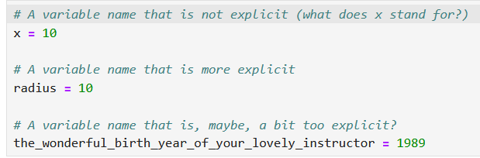
Matt’s Great Advice
Matt’s Great Advice: Try making your variables names explicit.
It is a good idea to make your variables names explicit (but not too much!) rather than using meaningless ones that leave your reader guessing what they stand for (x, y, a, b1, c2, etc.).
You can use underscores if you find it helpful (e.g. current_year = 2020).
Your future self, and colleagues, will thank you, when they work on your code later on.

Slide 6



Please download and install the Slido app on all computers you use
What happens if you use the command "print = 5" in Python?
ⓘ Start presenting to display the poll results on this slide.

Slide 7
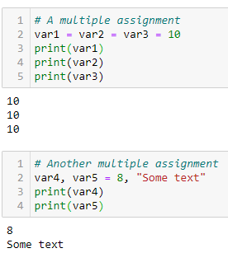
Multiple assignments
Python also allows multiple assignments using
Successive multiple equal signs: the value on the far right is assigned to all variables names identically.
Or by having several variables names and values separated by commas on both sides: the values are respectively assigned to the variables names, in a one for one manner.

Slide 8
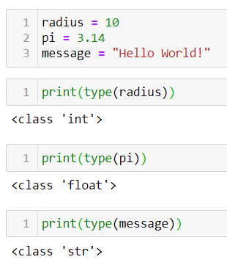
Variable types
Definition (variable type/class): Everything in your computer is stored in memory as 0s and 1s. A variable type/class defines how the sequence of 0s and 1s should be interpreted by the computer.
Let us start with three basic types:
int: an integer number.
float: a floating point number, for decimal numbers.
str: stands for string, a bunch of text.

Slide 9
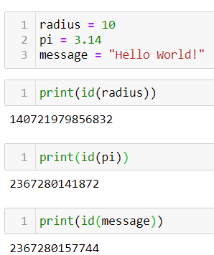
Variable IDs
Definition (variable ID): Everything in your computer is stored in memory as 0s and 1s.
A variable ID returns a number, corresponding to a memory address where the variable is being stored in memory.
The storing process for variables is automatically handled by your computer. More on this later, so let us keep it in mind.

Slide 10
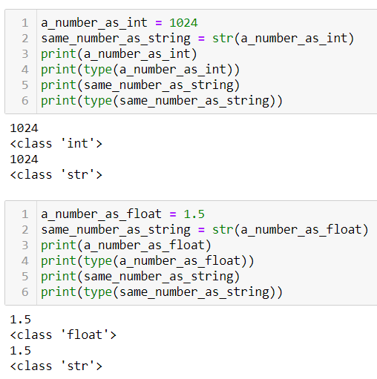
Type conversion
Int/Float → String: You can convert any int/float to a string using the str() function.
Note: Both the int/float and the str variables might print the same thing on screen, but they are not equivalent when it comes to what is stored in memory and how these variables can be used! For your computer, these two variables are very different things!

Slide 11
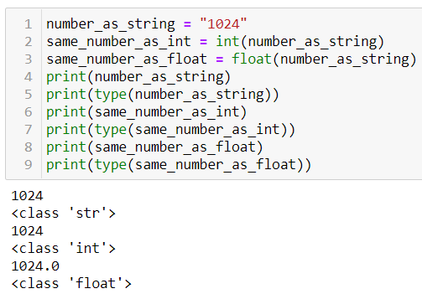
Type conversion
String → Int/Float: You can convert a string of digits to an int/float using int() or float().
A string containing only digits can be converted to int or float.
A string of digits may contain a single decimal point. In that case, it can be converted to a float, but not to an int.
Everything else fails (two decimal points, special characters, etc.).

Slide 12
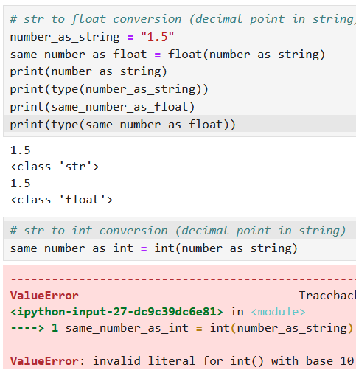
Type conversion
String → Int/Float: You can convert a string of digits to an int/float using int() or float().
A string containing only digits can be converted to int or float.
A string of digits may contain a single decimal point. In that case, it can be converted to a float, but not to an int.
Everything else fails (two decimal points, special characters, etc.).

Slide 13
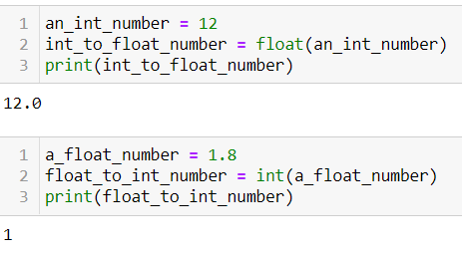
Type conversion
Int ←→ Float: You can convert a float to an int and vice versa.
Converting from int to float adds a single 0 decimal.
Also, converting from float to int, will drop all decimals (i.e. a truncation of all decimals, which is NOT the same as rounding!).
Feel free to experiment!

Slide 14
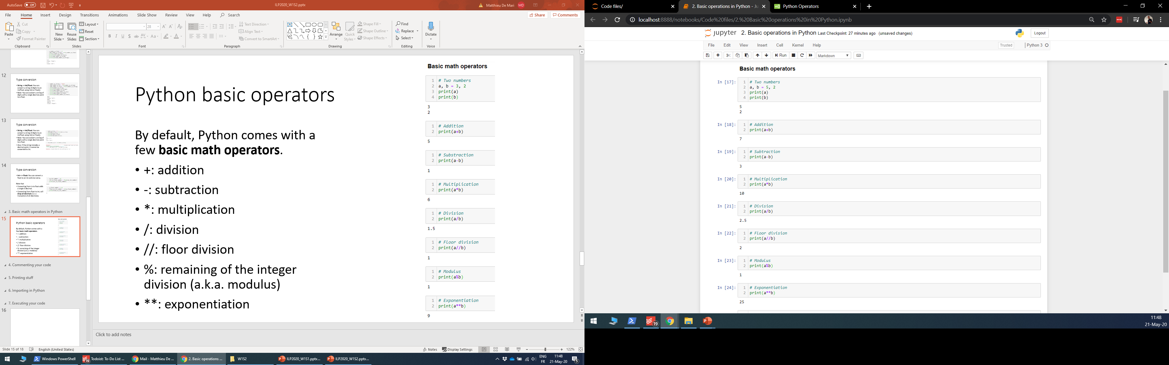
Python basic operators
By default, Python comes with a few basic math operators, for number (int/float) variables.
+: addition
-: subtraction
*: multiplication
/: division
//: integer division
%: remaining of the integer division (a.k.a. modulus)
**: exponentiation

Slide 15
Python basic operators
By default, Python comes with a few basic math operators, for number (int/float) variables.
+: addition
-: subtraction
*: multiplication
/: division
//: integer division
%: remaining of the integer division (a.k.a. modulus)
**: exponentiation
$$17$$
$$5$$
$$2$$
$$3$$
$$a\%b$$
$$a//b$$

Slide 16
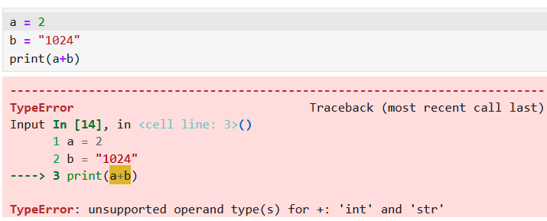
Python basic operators
By default, Python comes with a few basic math operators, for number (int/float) variables.
+: addition
-: subtraction
*: multiplication
/: division
//: integer division
%: remaining of the integer division (a.k.a. modulus)
**: exponentiation

Slide 17
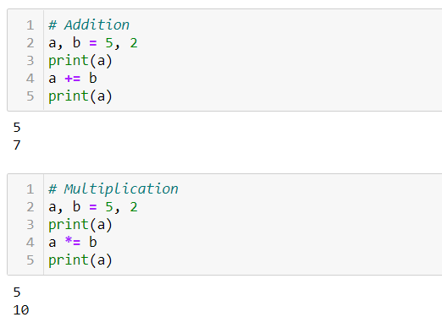
Combining operators and assignments
You can mix both mathematical and memory assignments operator.
For instance, the operation += sums values on the right- and left-hand sides and assigns the result to the variable on the left-hand side.
Similarly, we have the following operators: -=, *=, /=, //=, %=, **=.
Can you guess what they do?

Slide 18
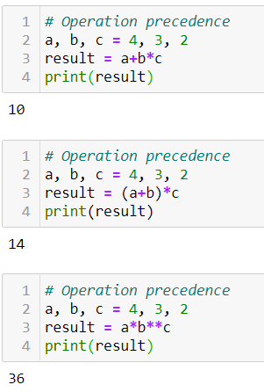
Operation precedence
Precedence order in Python: Operations are always computed from left to right.
However, operation precedence rules apply:
Exponentiation has higher precedence than multiplications/divisions/modulus, which have higher precedence than additions/subtractions.
As in mathematics, parentheses can be used to “force” precedence, as they will always have the highest precedence.

Slide 19
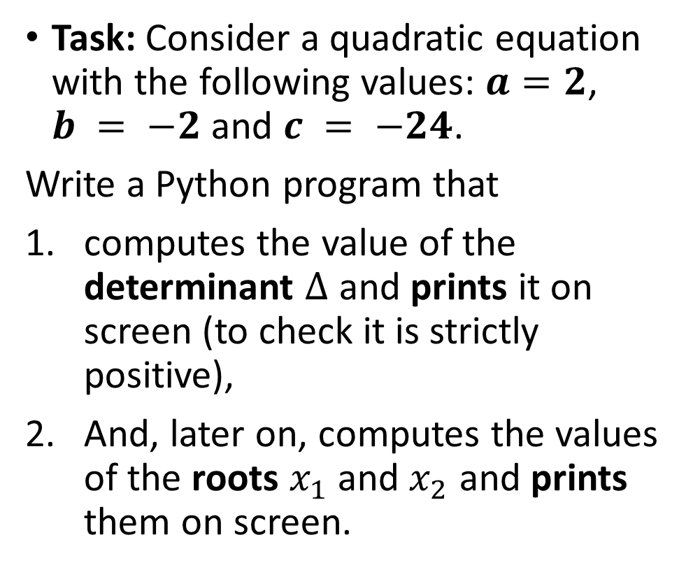
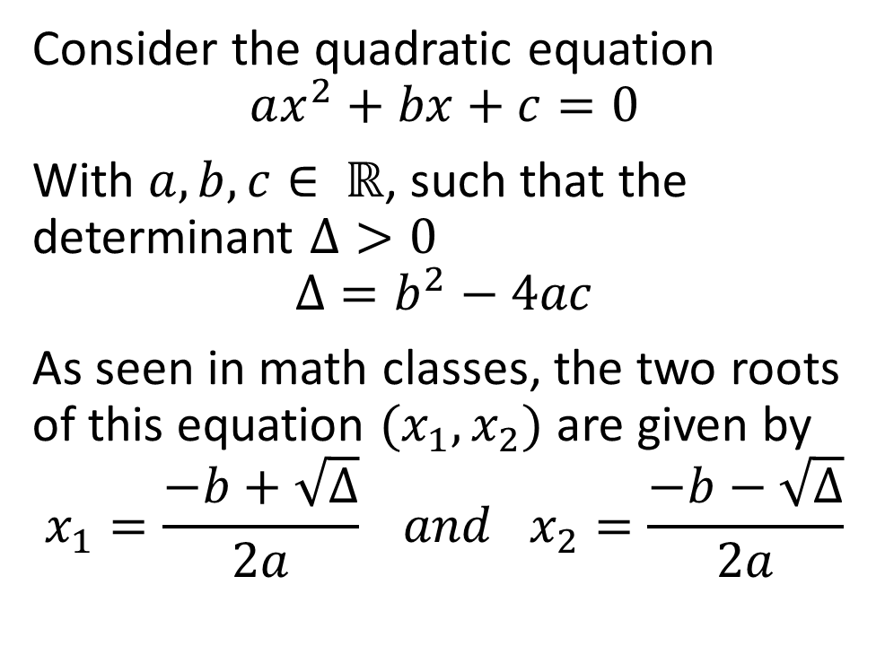
Activity 1: Compute the roots of a quadratic equation, with strictly positive determinant
Consider the quadratic equation
$$ax^{2}+bx+c=0$$
With $a, b, c∈ ℝ$, such that the determinant $Δ>0$
$$Δ=b^{2}−4ac$$
As seen in math classes, the two roots of this equation $(x_{1},x_{2})$ are given by
$$x_{1}=\frac{−b+\sqrt{Δ}}{2a} and x_{2}=\frac{−b−\sqrt{Δ}}{2a}$$
Task: Consider a quadratic equation with the following values: $a=2$, $b = −2$and $c = −24$.
Write a Python program that
computes the value of the determinant $Δ$ and prints it on screen (to check it is strictly positive),
And, later on, computes the values of the roots $x_{1}$ and $x_{2}$ and prints them on screen.

Slide 20
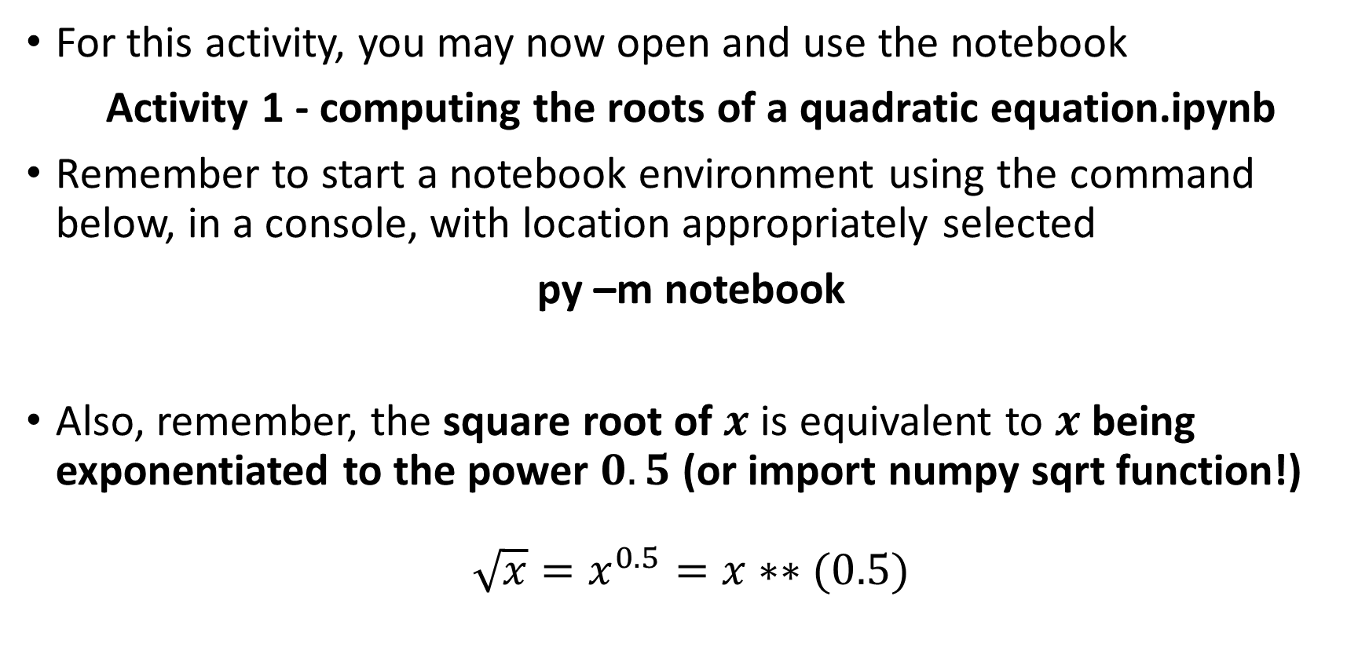
Activity 1: Compute the roots of a quadratic equation, with strictly positive determinant
For this activity, you may now open and use the notebook
Activity 1 - computing the roots of a quadratic equation.ipynb
Remember to start a notebook environment using the command below, in a console, with location appropriately selected
py –m notebook
Also, remember, the square root of $x$ is equivalent to $x$ being exponentiated to the power $0.5$ (or import numpy sqrt function!)
$$\sqrt{x}=x^{0.5}=x∗∗(0.5)$$

Slide 21
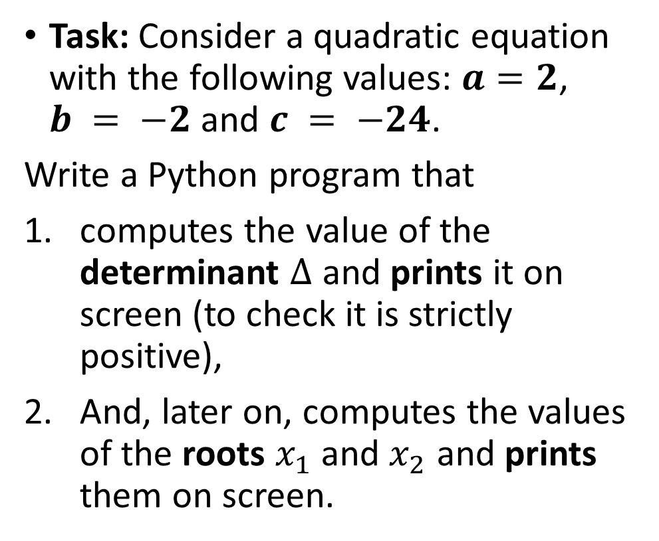
Activity 1: Compute the roots of a quadratic equation, with strictly positive determinant
Consider the quadratic equation
$$ax^{2}+bx+c=0$$
With $a, b, c∈ ℝ$, such that the determinant $Δ>0$
$$Δ=b^{2}−4ac$$
As seen in math classes, the two roots of this equation $(x_{1},x_{2})$ are given by
$$x_{1}=\frac{−b+\sqrt{Δ}}{2a} and x_{2}=\frac{−b−\sqrt{Δ}}{2a}$$
Task: Consider a quadratic equation with the following values: $a=2$, $b = −2$and $c = −24$.
Write a Python program that
computes the value of the determinant $Δ$ and prints it on screen (to check it is strictly positive),
And, later on, computes the values of the roots $x_{1}$ and $x_{2}$ and prints them on screen.
→ Expected answers: $Δ=196$, $x_{1}=4$, $x_{2}=−3$.

Slide 22
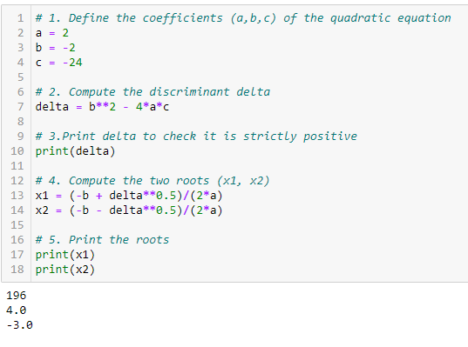
Activity 1: Solution
The solved notebook is in the Activity Solutions subfolder!

Slide 23
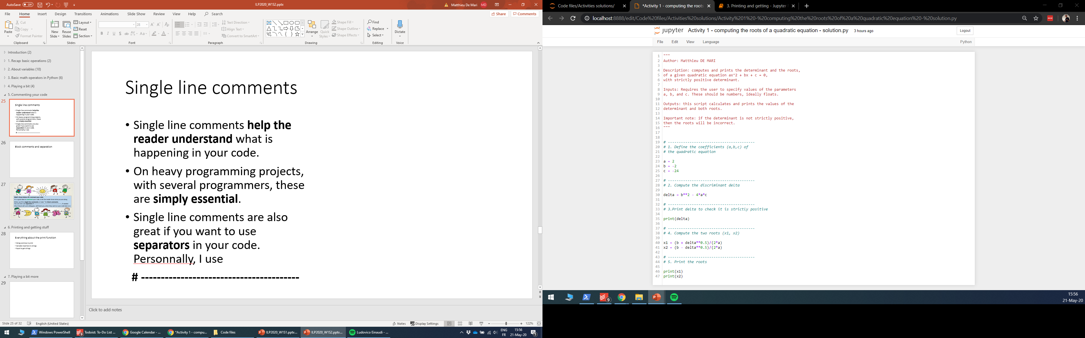
Single line comments
Definition (single line comments):
Single line comments help the reader understand what is happening in your code.
On heavy programming projects, with several programmers, these are simply essential.
Single line comments are also great if you want to use separators in your code. Personally, I use # ---------------.

Slide 24
Block comments
Definition (block comments):
Block comments are comments starting and ending with triple quotation marks (“”” or ‘’’).
These are great for headers in your files. Typically used, for instance, to inform the reader about the author, give a brief summary of what the code does, etc.

Slide 25
Block comments
Definition (block comments):
Block comments are comments starting and ending with triple quotation marks (“”” or ‘’’).
These are great for headers in your files. Typically used, for instance, to inform the reader about the author, give a brief summary of what the code does, etc.

Slide 26
Matt’s Great advice
Matt’s Great Advice: Comment your own code… Seriously… Do it.
It is always a good idea to comment your code, to let the reader know what your script does.
Either use # for single line comments or triple quotations (“””) for block comments.
You can even use separators (# ------), for readability, if needed.
Again, your future self and colleagues will be grateful, when they read code you have written.

Slide 27
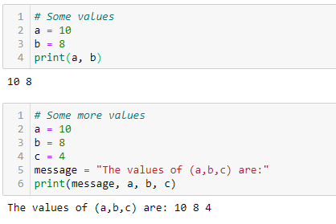
About the print() function
You can print multiple variables at once, using a single print(), by simply separating the different variables with commas.
You can even mix several types of variables inside of a single print, using commas as a separator.
The print() function always tries its best to show you the values of what you are requesting!

Slide 28
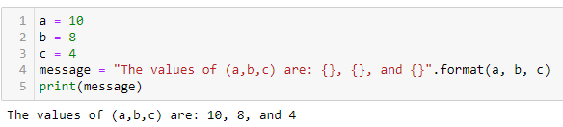
About the print(), and the format() function
Definition (the format() method): The format() method can be used to insert the value of a variable in another string variable.
It requires some placeholders {} in the string, and some variables passed to the format() method. Placeholders are simply replaced with the values of the variables passed to the format() method.
Note: format() is a special kind of function called a method. Notice how it is applied to a string variable using the dot operator.

Slide 29
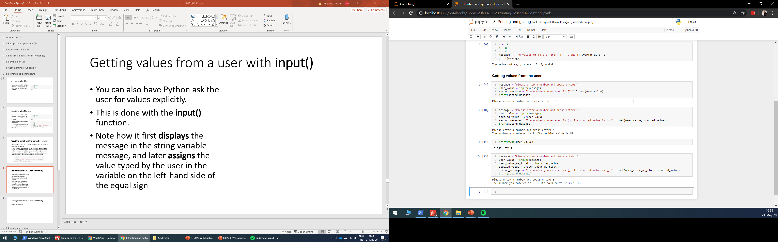
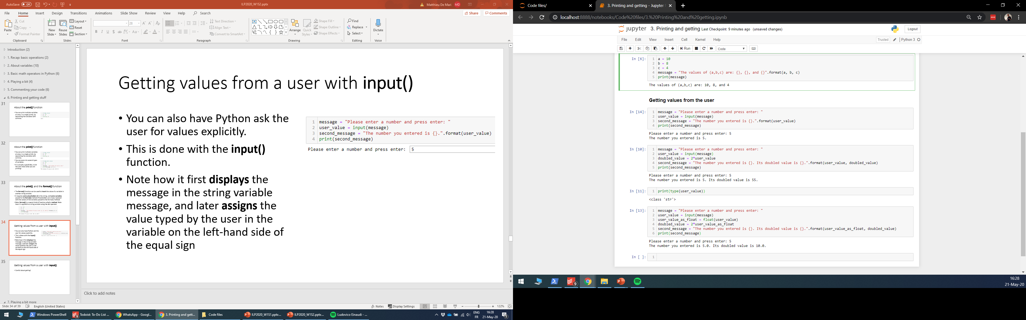
Getting values from a user with input()
Definition (the input() function): You can also have Python ask the user for values explicitly. This is done with the input() function.
Notice how it first displays the string variable message and a submission box,
And later assigns the value typed by the user in the variable on the left-hand side of the equal sign used for input().

Slide 30
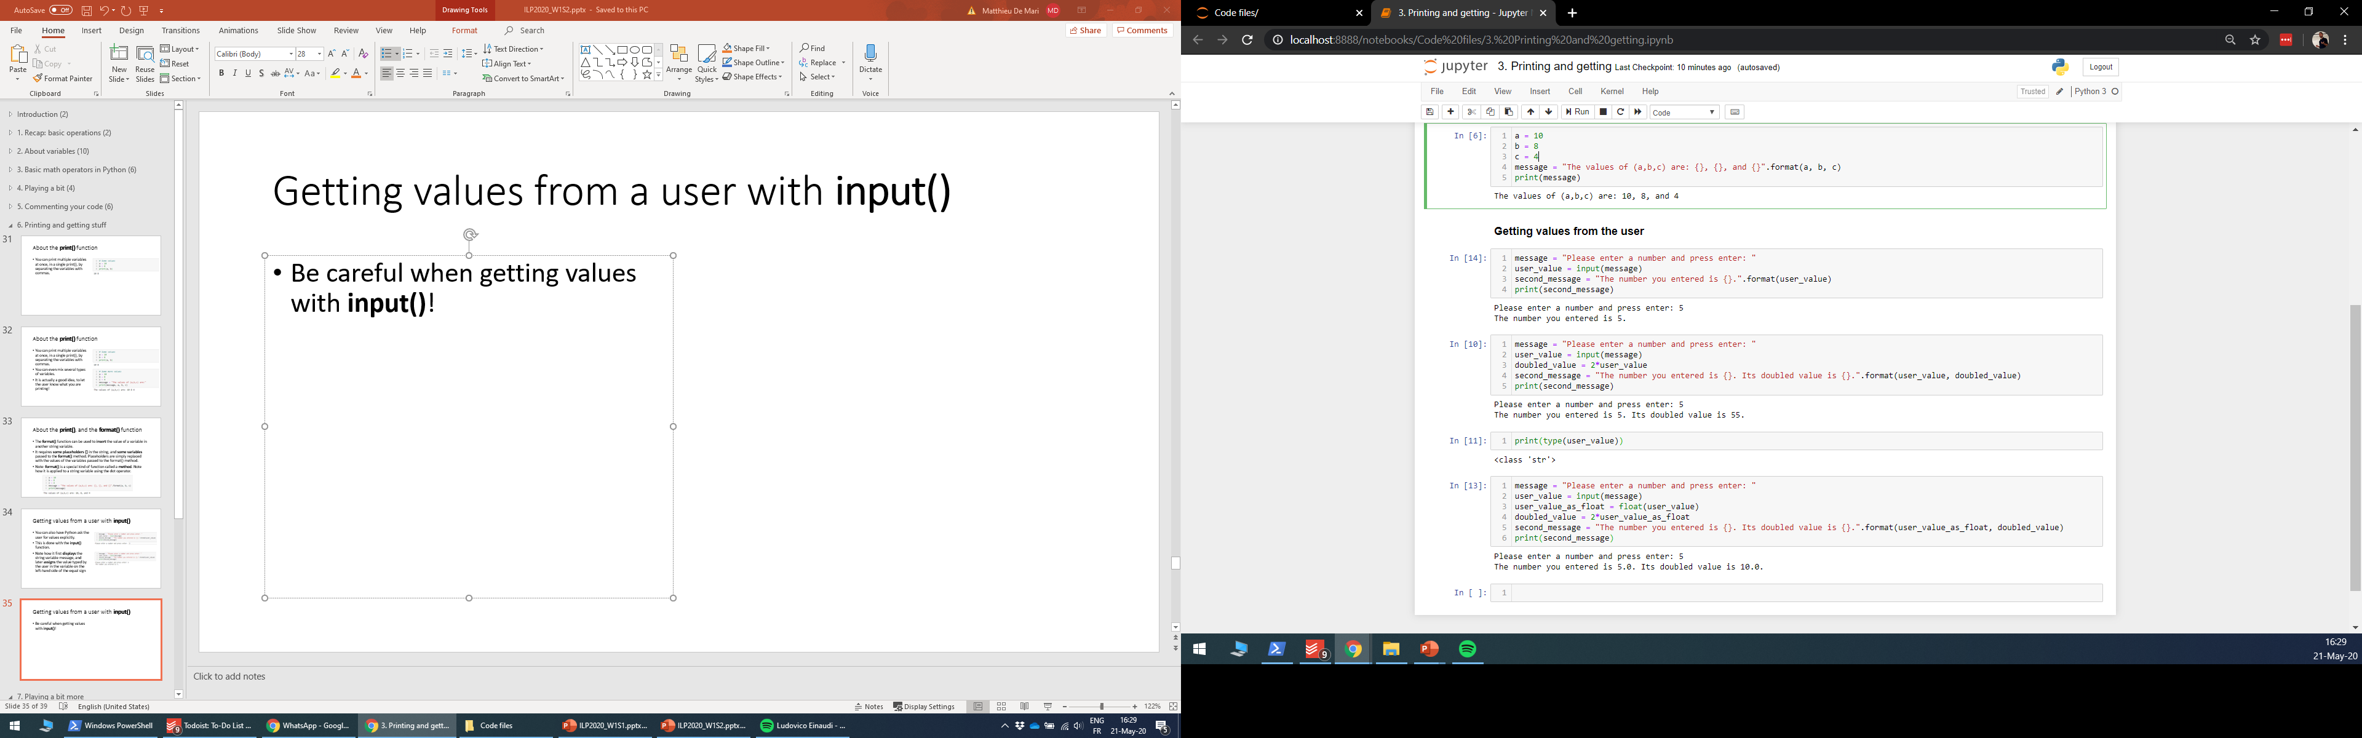
Getting values from a user with input()
Important: Be careful when getting values with input()!
In this program, I asked the user to enter a number,
Doubled the value of said number,
And later displayed both the original number and its doubled value.
Problem: Something strange occurs… But why?

Slide 31
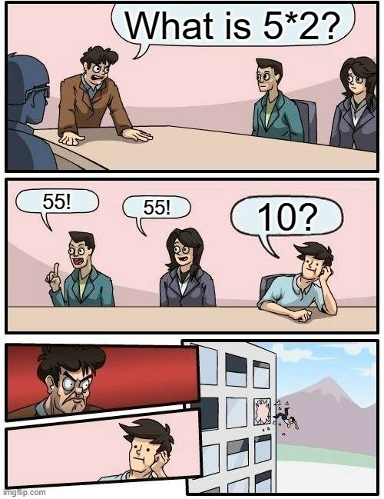

Has Python gone mad?

Slide 32
Getting values from a user with input()
Important note: The values retrieved from users with input() will always be typed as string variables!

Slide 33

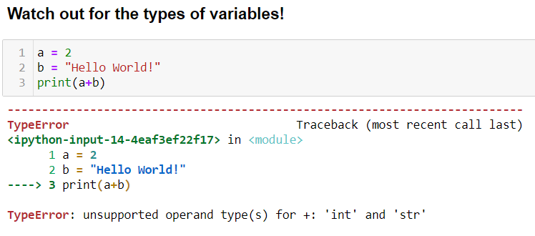
Reminder: we do not do math with strings!
By default, Python comes with a few basic math operators, for number (int/float) variables.
+: addition
-: subtraction
*: multiplication
/: division
//: integer division
%: remaining of the integer division (a.k.a. modulus)
**: exponentiation

Slide 34
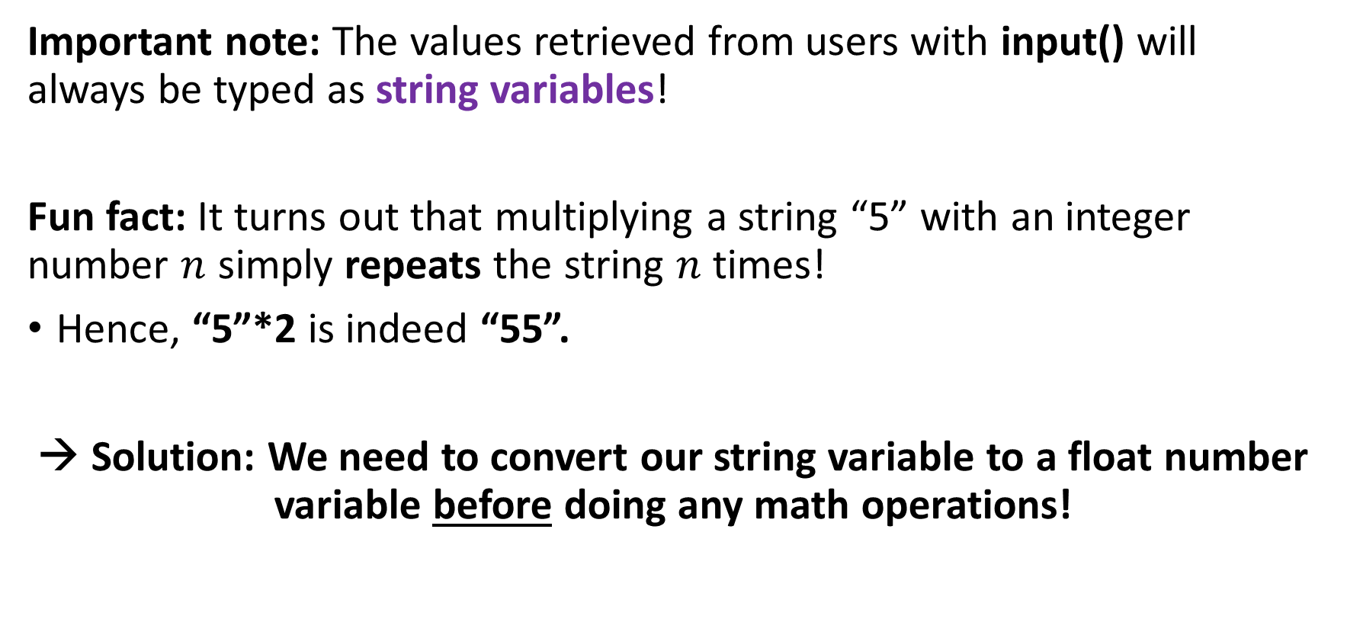
Getting values from a user with input()
Important note: The values retrieved from users with input() will always be typed as string variables!
Fun fact: It turns out that multiplying a string “5” with an integer number $n$ simply repeats the string $n$ times!
Hence, “5”*2 is indeed “55”.
→ Solution: We need to convert our string variable to a float number variable before doing any math operations!

Slide 35
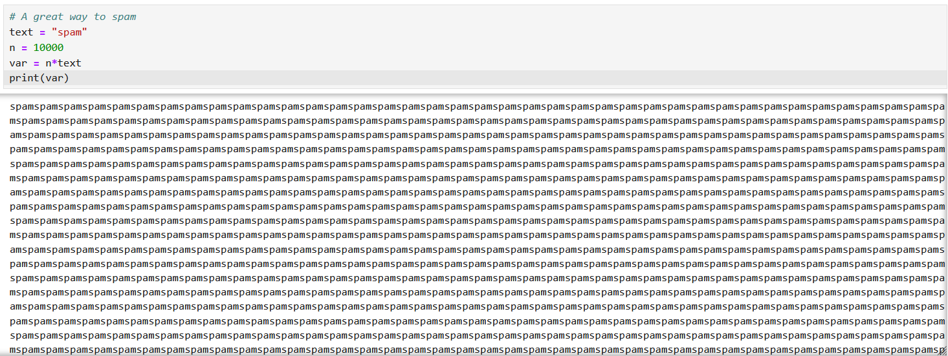
How to spam your ennemies
Important: The values retrieved from users with input() will always be typed as string variables!
Fun fact: multiplying a string “5” with an integer number $n$ simply repeats the string $n$ times!
Hence, “5”*2 is indeed “55”.
→ Solution: We need to convert our string variable to a float number variable before doing any math operations!

Slide 36
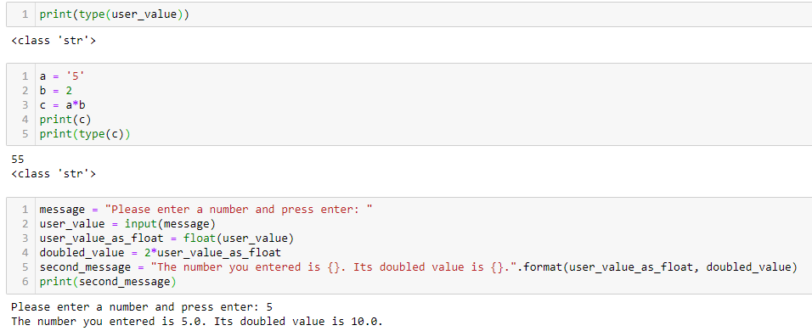
Fixing our faulty code

Slide 37
Matt’s Great advice
Matt’s Great Advice: Watch out for variables types with basic math operators!
The behavior of a basic math operator (+, -, *, etc.) might change, depending on the types of the variables involved in the calculation.
This is called operator overloading and is a perfectly normal feature of Python programming.
For instance, multiplying a string and a number variables is not the same as multiplying two number variables!

Slide 38
Activity 2: Ask users about personal details
Task: Write a Python script that explicitly asks the user for its name and its birth year using text prompts. Later on, the scripts should display a message, reading
Your name is _________, and your age is either ____ or ____.
You can use the second notebook
Activity 2 - Asking users for personal details.ipynb
(If you finish early, have a look at the extra practice/challenges folder!)

Slide 39
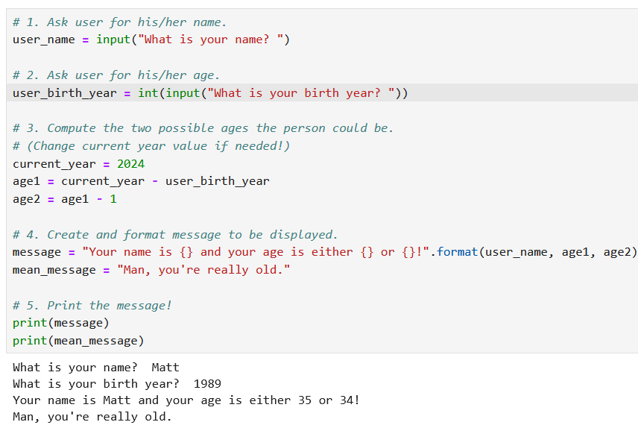
Activity 2: Ask users about personal details

Slide 40
Conclusion (Chapter 2)
Everything you need to know about variables: Naming conventions, types, IDs, assignments, types conversions.
Using basic math operators in Python on mathematical variables: +, -, *, /, //, %, **.
Combining operators and assignments.
Commenting: in-line, block, docstring and header comments.
Printing and getting: displaying with print(), getting with input().
And more things!

